Slide 1


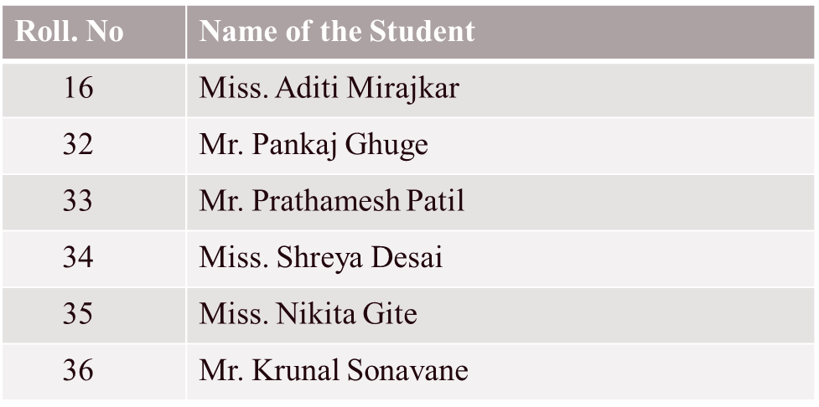

IMPACT OF CLIMATE CHANGE ON BIRDS
Under the Guidance of - Prof. Meghana Bandivadekar
DY Patil College of Engineering and Technology, Kolhapur
Academic Year- 2024-25

Slide 2

Contents
1
Introduction
2
Problem Statement
3
Need Of Work
4
Objectives
5
System Architecture
6
Modules
7
Snapshots
8
System Requirements
9
Conclusion

Slide 3
Introduction
The project predicts future habitat suitability for a vulnerable species by integrating climate data and species occurrence records.
Using machine learning techniques, the model analyzes how changes in climate variables affect the distribution of the birds, providing actionable insights for conservation strategies to mitigate the impacts of climate change.

Slide 4
Problem Statement
To develop an advanced web application that shifts in birds population due to climate change, accurate modeling of their complex ecological interactions is crucial for effective conservation efforts.

Slide 5
Need Of work
• Effective Conservation Planning
• Understanding Climate Impacts
• Advancing Methodological Approaches
• Integrating Diverse Data Sources
• Visualizing and Communicating Results

Slide 6
Objectives
To combine historical climate data and species occurrence records to create a unified dataset.
To build a model to predict where the birds might live in the future.
To create maps to show how the bird habitat might change over time.
To use the information to help protect the birds and analyze the influence of specific climate variables such as temperature etc.

Slide 7
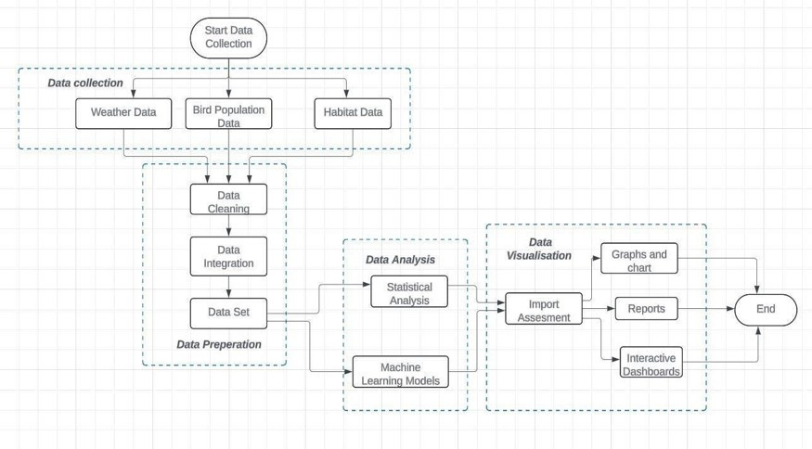
System Architecture

Slide 8
Modules
Data Collection and Preprocessing
Data Analysis
Evaluation
Prediction and Forecasting

Slide 9
System Requirements
Processor: Intel i5, i7, or equivalent (e.g., AMD Ryzen 5/7).
RAM: Minimum 16GB or higher for efficient performance.
Data Collection Devices: GPS devices for location-based data tracking.
Storage Solutions:
Physical: External Hard Drives or Network Attached Storage (NAS) for secure data backup.

Slide 10
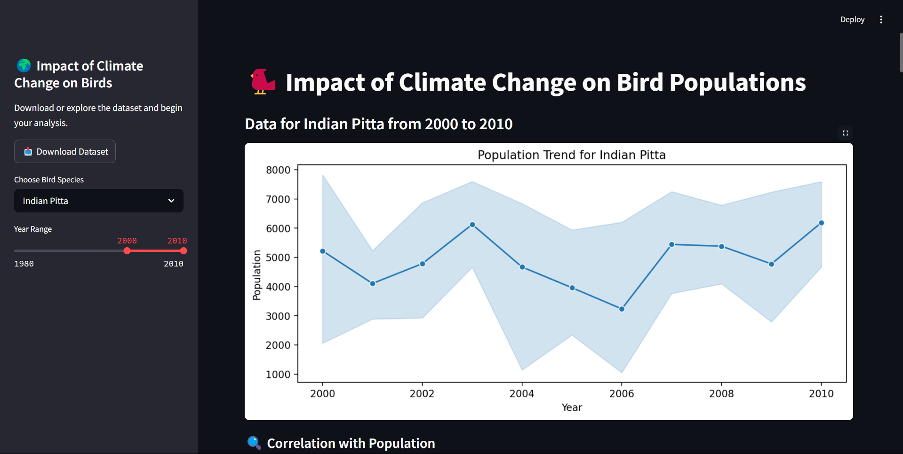
Snapshots

Slide 11
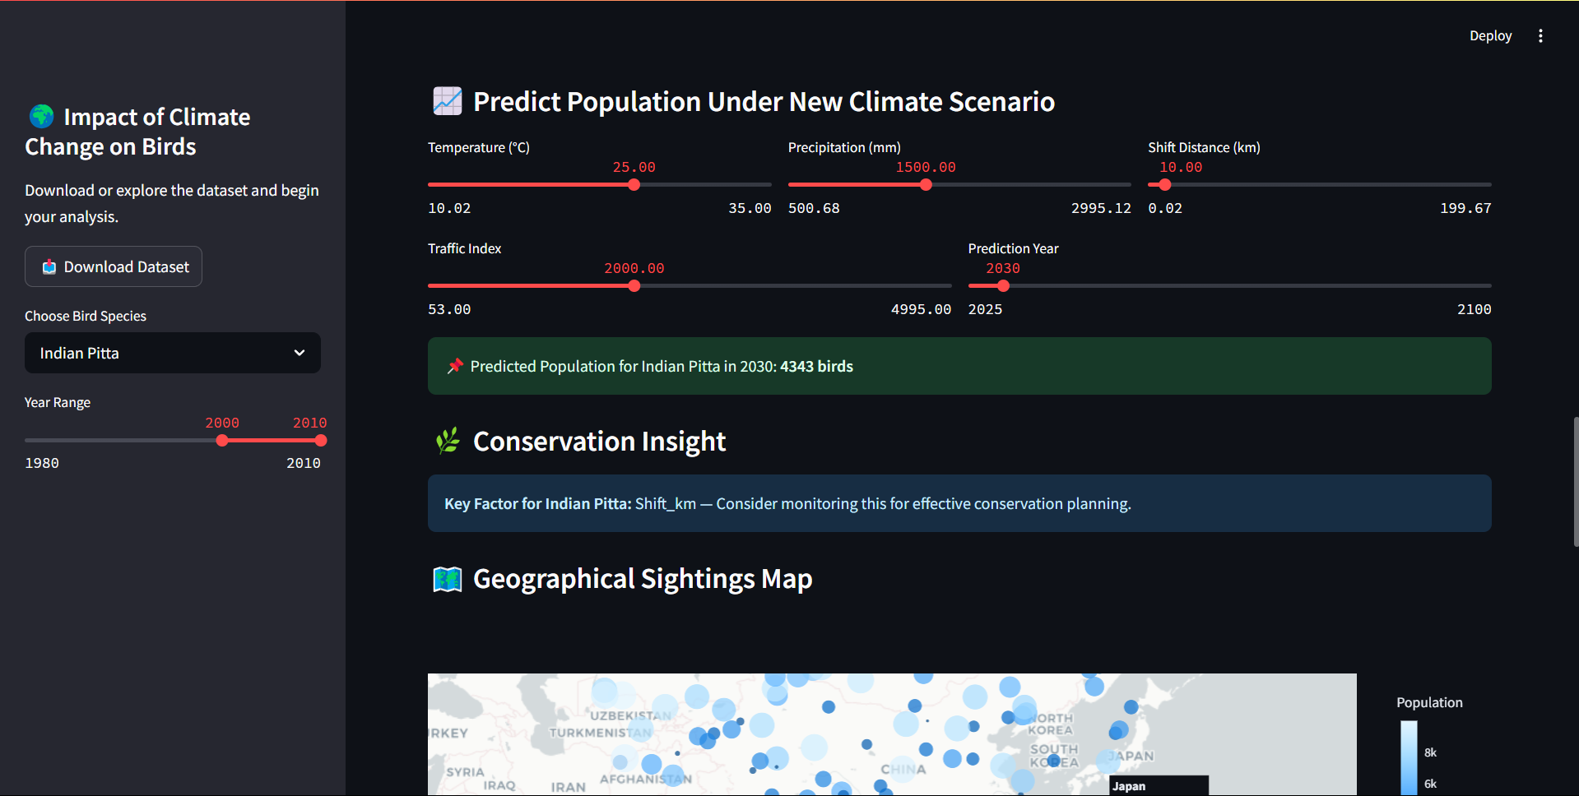
Snapshots

Slide 12
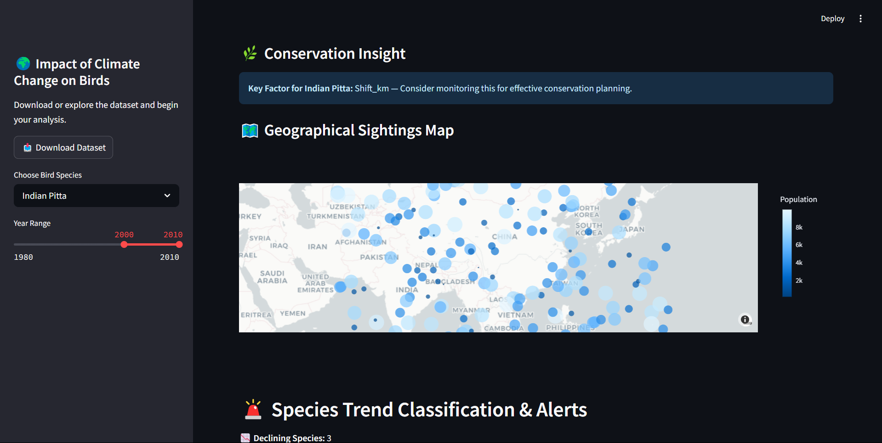
Snapshots

Slide 13
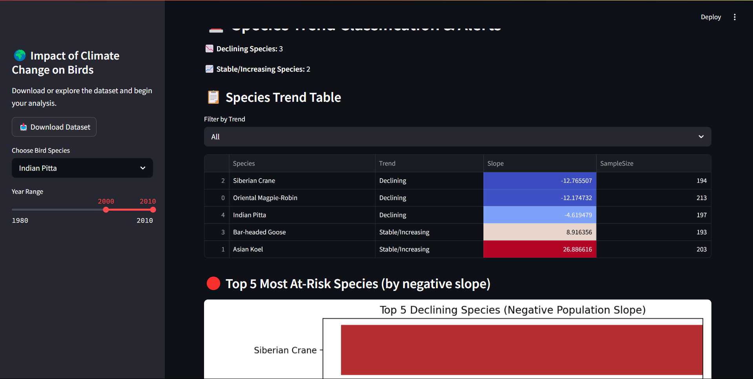
Snapshots

Slide 14
Conclusion
We conclude that developing a system to analyze climate change's impact on bird populations is essential for effective ecological monitoring. Utilizing advanced visualization and modeling techniques can provide valuable insights to guide biodiversity conservation efforts.

Slide 15
Thank
You

